Slide 1
Predictive Analytics for Customer Churn
Presented by
Name:

Slide 2
The Challenge: Customer attrition remains a critical bottleneck for sustained revenue growth. Traditional reactive measures are no longer sufficient in a highly competitive market landscape.
Preface &
Objective
Our Objective: To engineer and evaluate a robust, proactive predictive model capable of identifying at-risk accounts with high precision before the point of departure.
The Scope: This presentation outlines the rigorous methodology applied to historical CRM data and presents the quantitative results of our advanced algorithmic evaluations.

Slide 3









Methodology: The Core Pipeline
1. Data Ingestion
2. Feature Engineering
3. Model Training
Aggregated 1.2 million customer interaction records across multiple silos, including transactional history, support tickets, and engagement metrics.
Implemented k-fold cross-validation across three distinct algorithmic architectures to ensure model robustness and prevent overfitting.
Derived 45 novel behavioral features. Applied Synthetic Minority Over-sampling Technique (SMOTE) to balance the highly skewed churn dataset.

Slide 4


Algorithm Selection & Tuning
To establish a highly accurate predictive baseline, we deployed a multi-model approach, rigorously testing algorithms tailored for binary classification tasks.
Logistic Regression: Utilized as the baseline model for its interpretability and computational efficiency.
Random Forest: Deployed to capture non-linear relationships and complex interaction effects among behavioral features.
XGBoost: Implemented for advanced gradient boosting, handling missing data internally and optimizing for precision.
Hyperparameter Optimization: Executed via Bayesian Optimization to systematically find the global optima for model parameters.

Slide 5
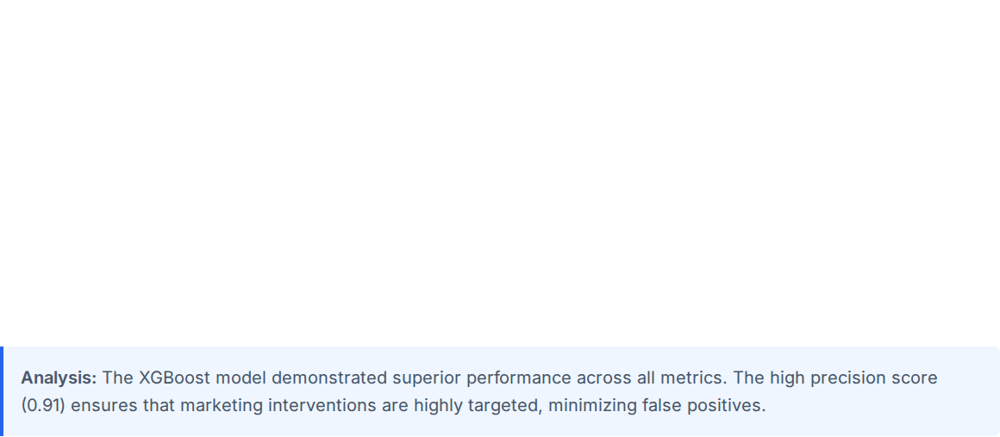
Results: Evaluation Metrics Matrix
Model Architecture | Accuracy | Precision | Recall | F1-Score
Logistic Regression (Baseline) | 78.4% | 0.72 | 0.68 | 0.70
Support Vector Machine (SVM) | 82.1% | 0.79 | 0.75 | 0.77
Random Forest Classifier | 89.5% | 0.86 | 0.84 | 0.85
XGBoost (Optimized) | 94.2% | 0.91 | 0.89 | 0.90

Slide 6
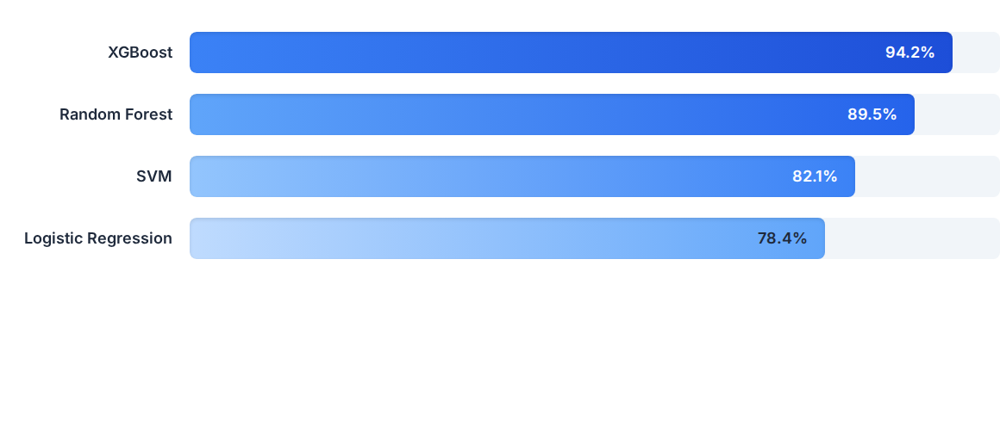
Results: Comparative Accuracy
The gradient boosted approach (XGBoost) provides a definitive 15.8% accuracy uplift over the traditional baseline, confirming the necessity of complex ensemble modeling for this dataset.

Slide 7
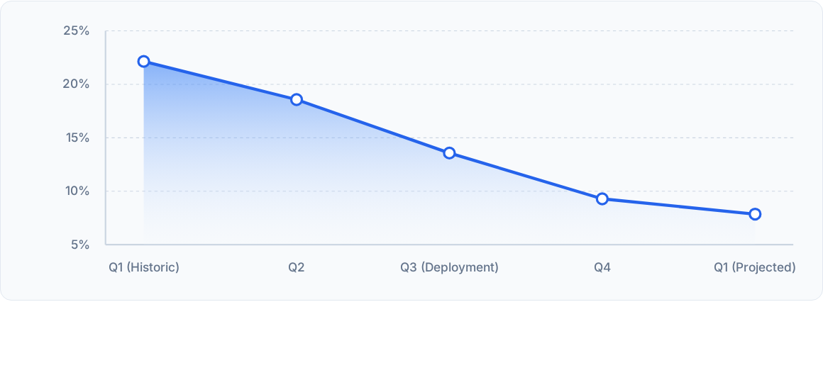
Results: Simulated Churn Reduction Trend
Projection simulation: By implementing the XGBoost model outputs into our customer success workflow in Q3, we project a steady decline in the global churn rate, stabilizing near 6.5% by early next year.

Slide 8

Questions & Discussion
Thank you for your time.
data.science@company.com
analytics.company.internal

